Slide 1
Pneumonia detection in
chest X-ray by H-mask techniques

Slide 2
Content
Abstract
Proposed method
Implementation
Model Comparison.
Outcomes/Future goal
Conclusion
Reference

Slide 3
1.Abstract
Pneumonia, a common respiratory disease, is a major worldwide health problem. we particularly focus on pneumonia detention in chest X-ray.
However, the complexities of interpreting these pictures demand new approaches for reliable detection. This research introduces a unique strategy that uses the H-mask technique to improve the detection of pneumonia indications in chest X-ray images.
We establish the efficiency of this strategy and its potential influence on clinical practice through rigorous tests and comparative research.
Additionally deal with critical issues such as parameter selection, resource optimization, and model selection to ensure practical viability for real-world clinical applications.

Slide 4
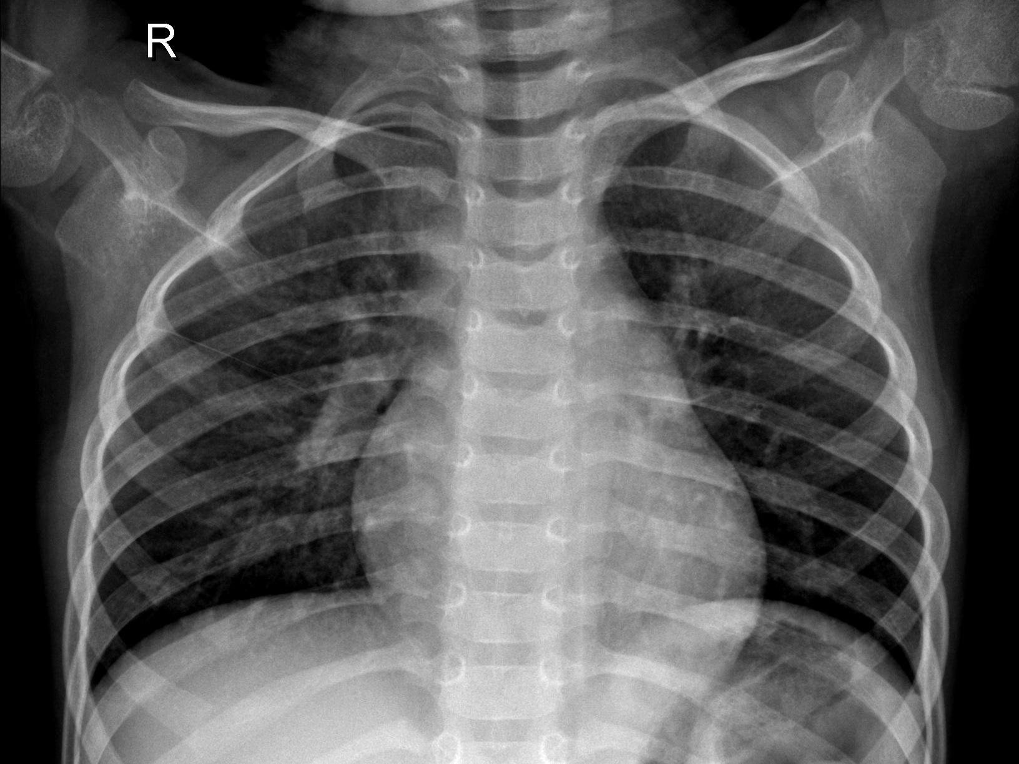
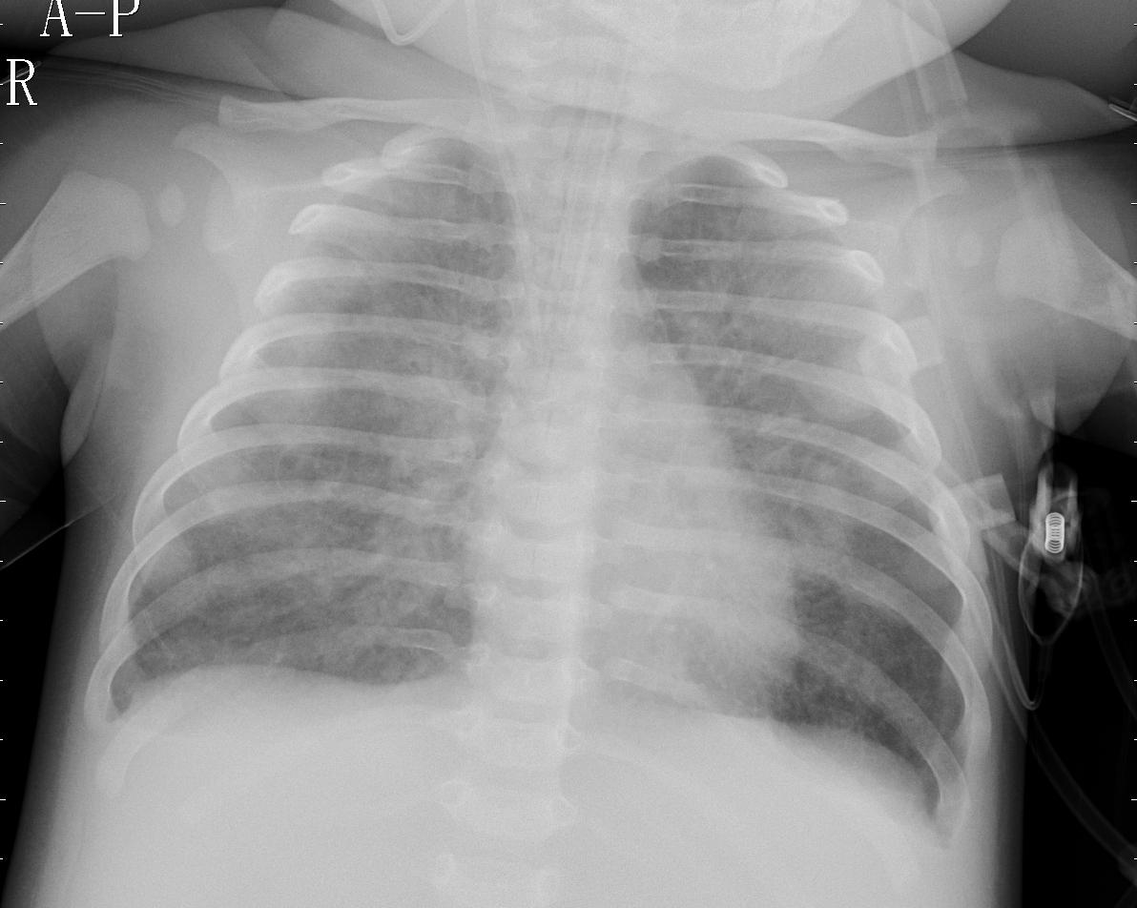
1.Data source
Chest X-Ray Dataset : https://www.kaggle.com/datasets/paultimothymooney/chest-xray-pneumonia
Dataset | Normal | Pneumonia | Total
Train | 1349 | 3883 | 5232
Test | 234 | 390 | 640
Validation | 8 | 8 | 16

Slide 5
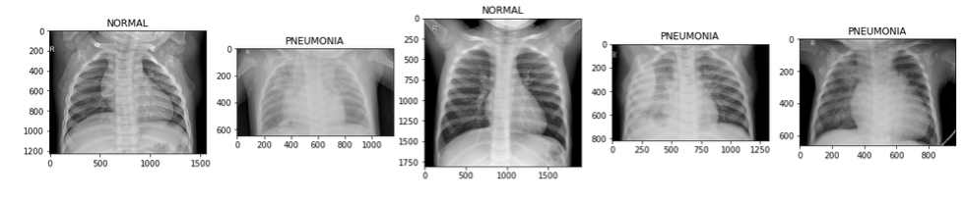
1.Data representation

Slide 6
2.Proposed method (Block method vs H-mask method)
Block method : It involves classifying the chest X-ray picture into distinct, non-overlapping chunk.
This technique fulfills two functions.
It allows the model to detect specific features that may indicate pneumonia.
It provides a technique for completely evaluating the whole picture, to guarantee no potential information is ignored.
H-mask method : The H-mask approach offers a significant advancement in recognizing signs of pneumonia.

Slide 7
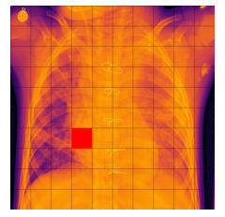



2.Proposed method (Block method vs H-mask method)

Slide 8
3.Implementation
Standardize dimensionality of data
Generate & extract H-shaped
Model selection
Parameter selection
Resource optimization

Slide 9
3.1 Standardize dimensionality of data
Before the formation of an H-shaped mask, we have to ensure that all processed data have equal dimensions. Chest X-ray dimensionality ranges from 600*2400.
So we generalized them by 1000*1000 as well as 912*912 by using Image.resize() from the PIL package.

Slide 10
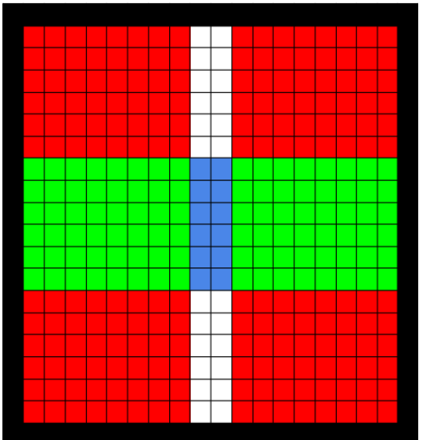
3.2 Generate & Extract H-mask
Bar_height = (grid_size - 2 * spacing) // 3
Rectangle
([(spacing, spacing), (spacing + bar_width, grid_size - spacing)]
Rectangle
([(grid_size - spacing - bar_width, spacing), (grid_size - spacing, grid_size - spacing)]
Rectangle
([(spacing, spacing + bar_height), (grid_size - spacing, spacing + bar_height + bar_width)]

Slide 11
3.3 Model selection
Each model brings unique strengths in feature extraction and pattern recognition.
Comparative analyses are conducted to assess their performance in conjunction with the H-mask technique.
CNN
VGG-16
VGG-19

Slide 12
3.4 Parameter selection
Model efficiency and performance depend on parameters used while training.
Factor that affects overall model performance.
Computational power
Model capacity and complexity
Memory and storage constrain
To avoid overfitting/underfitting

Slide 13
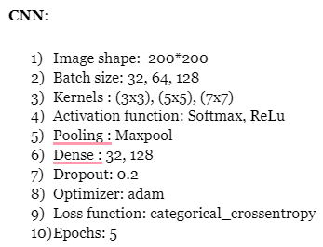
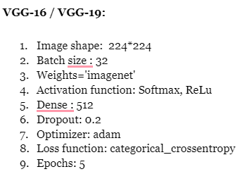
3.4 Parameter selection

Slide 14
3.5 Resource optimization
As the medical field has limited resources for emerging diseases, our approach towards training models with a portion of H-mask resources and evaluating performance.
Throughout this experiment, we check models with 6 distinct portions of the dataset.

Slide 15
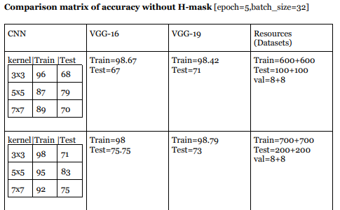
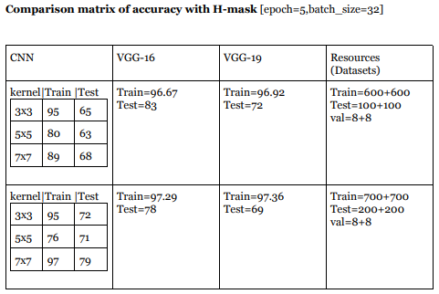
4. Model Comparison

Slide 16
5. Outcomes/ Future goal
Above model comparison with CNN, VGG-16, and VGG-19, we analyzed the proposed H-mask method gives a higher testing accuracy for VGG-16 as compared to without H-mask for a dataset of 1200[600 normal, 600 pneumonia] training data,
200 [normal:100, pneumonia:100] testing
16 validation data
For the upcoming process, we will introduce a method for the detection of pneumonia-affected regions in chest X-rays by using combined techniques of the H-mask and R-CNN model.

Slide 17
6. Conclusion
All things considered, this work is a major step toward transforming the way the H-mask approach is used to identify pneumonia.
By offering quicker and more accurate diagnoses, the suggested approach has the potential to completely transform clinical practice

Slide 18
7. References
Mooney, P. (2018). Chest X-ray Images (Pneumonia). Kaggle. https://www.kaggle.com/paultimothymooney/chest-xray-pneumonia
Kan, M. (n.d.). Convolutional Neural Network (CNN) Tutorial. Kaggle. https://www.kaggle.com/code/kanncaa1/convolutional-neural-network-cnn-tutorial
Victor Ikechukwu, A., Murali, S., Deepu, R., & Shivamurthy, R. (2021). ResNet-50 vs VGG-19 vs training from scratch: A comparative analysis of the segmentation and classification of Pneumonia from chest X-ray images. Global Transitions Proceedings, 2(2), 375–381. https://doi.org/10.1016/j.gltp.2021.08.027
Ruder, S. (n.d.). Convolutional Neural Networks Cheatsheet. Stanford University. https://stanford.edu/~shervine/teaching/cs-230/cheatsheet-convolutional-neural-networks
Mandal,M. (2023, June 30). Introduction to Convolutional Neural Networks (CNN). Analytics Vidhya. https://www.analyticsvidhya.com/blog/2021/05/convolutional-neural-networks-cnn/
Suthaharan, S. (2016). Ch-12 Deep Learning Models. In Machine Learning Models and Algorithms for Big Data Classification (p. 289). Springer. https://link.springer.com/book/10.1007/978-1-4899-7641-3

Slide 19


Thank you

